Slide 1

G r a m m a r
Количественные местоимения
(Quantifiers)
Much, many, little, few

Slide 2
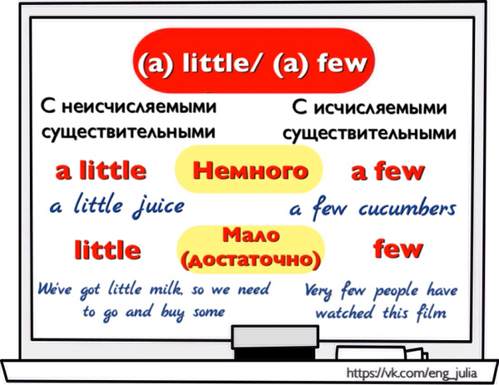

Slide 3
Much, many, little, few
Much, little
Many, few
употребляются с неисчисляемыми существительными:
употребляются с
исчисляемыми существительными:
much time much luck
little energy little money
many friends many people
few cars few countries

Slide 4

A lot (of), lots (of), plenty (of)
Употребляются с
неисчисляемыми существительными
существительными во
множественном числе:
и
a lot of juice lots of time
plenty of money
a lot of students
lots of shops
plenty of ideas
Plenty часто используется в значении 'более чем достаточно'

Slide 5
much many
употребляются, в основном, в
отрицательных предложениях и в вопросах:
- We didn't waste much time.
- Have you written many poems?
В утвердительных предложениях лучше употреблять
a lot (of) вместо much :
- We wasted a lot of food. (а не `we wasted much food')
- There has been a lot of rain recently. (а не `much rain')
Однако too much и so much
употребляются в утвердительных предложениях:
- She won't drink this coffee. There's too much sugar in it.
- There was so much sugar in the coffee that she couldn't drink it.

Slide 6
Little / a little few / a few
Little и few (без артикля a)
придают характеру действия негативный оттенок:
- Ask Tom to take a car. We've got little time.
(= немного, недостаточно времени)
- He's not friendly. He has few friends.
(= немного, недостаточно друзей)
A little и a few показывают более позитивное отношение к
небольшому количеству или числу:
- Let's go and see the town. We've got a little time before the train leaves.
(= немного времени, но достаточно чтобы посмотреть город)
- I enjoy my life here. I have a few friends and we meet quite often.
(a few friends = not many but enough to have a good time)
- `When did he phone you last?' `A few days ago.' (= some days ago)

Slide 7
very little / very few only a little / only a few
Запомните усилительные формы
very little и very few :
- We've got very little butter.
- He has very few clothes.
only a little и only a few
имеют отрицательное значение:
- Say that you'll call him later. We've only got a little time.
- The beach was empty. There were only a few swimmers.

Slide 8

Yes
Yes!
Test 6
Test1
Test 7
Test 2
Test 8
Test 3-4
Test 9
Test 5
Test 10

Slide 9

No
No ...
Test 1
Test 6
Test 7
Test 2
Test 8
Test 3- 4
Test 9
Test 5
Test 10

Slide 10
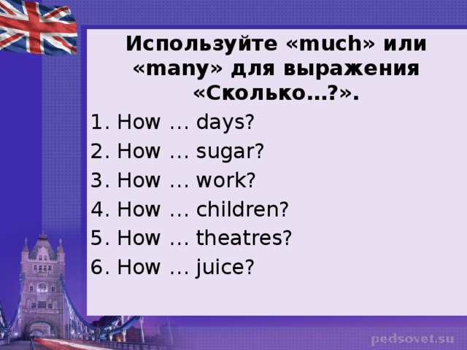

Slide 11
Тест 1. Much или many?
1) We know ... English and American songs. | much | many
2) There are ... rooms in the house. | much | many
3) Does she read ...? | much | many
4) There is not... milk in the cup. | much | many
5) There is ... snow on the ground in winter. | much | many
6) There is ... light in the room, because there are four windows in it. | much | many
7)... people in the world speak English. | much | many
8)... of my friends swim well. | much | many

Slide 12
Тест 2. Little или few?
1) I have ... time to speak to you. | Little | few
2) There is ... sugar in the tea. | Little | few
3) I have ... friends in London. | Little | few
4) There were ... boys on her birthday party. | Little | few
5) I had very ... pleasure to do everything myself. | Little | few
6) ... has been said about his new book. | Little | few
7) There was ... salt in the pot. | Little | few
8) Many children were invited on the party but... came. | Little | few

Slide 13
Тест 3. Выберите нужное местоимение.
Please, give me ... milk.
a) little b) a little c) a lot of
d) few e) a few f) many
2) I have ... books on English history.
a) little b) a little c) a lot of
d) few e) a few f) many
Тест 4. Выберите слово, которым можно заменить выделенное так,
чтобы не изменился смысл предложения.
People drink much juice in summer.
a) few b) a lot of c) little d) many

Slide 14
Тест 5. Much или many?
1. Is there . . . snow in the streets? | much | many
2. There aren't . . . lamps. | much | many
3. How … rooms are there in your flat? | much | many
4. There isn't . . . coffee in the cups. | much | many
5. Have you . . . friends in your class? | much | many
6. Has she . . . homework for today? | much | many
7. How … bread is there on the plate? | much | many
8. How … coffee is there in the jar? | much | many
9. You play computer games too … . | much | many
10.There aren't ...people standing at the bus stop. | much | many

Slide 15
Тест 6. Much или many?
1. Thank you very.... | much | many
2. My friend didn 't make... mistakes. | much | many
3. How... money have you got? | much | many
4. There isn't... milk in the bottle. | much | many
5.I haven't got... time, but I'll try to help you. | much | many
6.Have your parents been to... countries? | much | many
7. There weren't... people in the street. | much | many
8. Has your son made... friends in France? | much | many
9. Dan doesn't spend... money on his clothes. | much | many
10. You watch TV too.... | much | many
11. Was there... traffic in sight? | much | many
12. Did you take... photos in Spain? | much | many
13. Try to do as... as possible. | much | many
14. Do you get... letters every week? | much | many
15. My wife didn't speak... at the party. | much | many
16.I enjoyed the concert very.... | much | many
17. Sue took as... books as she could carry herself. | much | many

Slide 16
Тест 7. Much или many; a lot или a lot of ?
1 Do you drink … tea? | much | many | a lot | a lot of
2 I like reading. I've got ... books. | much | many | a lot | a lot of
3 There isn't ... milk in the fridge. | much | many | a lot | a lot of
4 It costs ... money to travel round the world. | much | many | a lot | a lot of
5 Please be quick, I haven't got ... time. | much | many | a lot | a lot of
6 How ... foreign languages can you speak? | much | many | a lot | a lot of
7 They didn't ask me ... questions. | much | many | a lot | a lot of
8 There was ... food at the party but I didn't eat. | much | many | a lot | a lot of
9 We saw ... interesting things in the museum. | much | many | a lot | a lot of
10 George knows ... about economics. | much | many | a lot | a lot of
11 We went on a cheap holiday. It didn't cost … | much | many | a lot | a lot of
12 ‘Did you enjoy the party?' 'No, not ... ' | much | many | a lot | a lot of
13 Most of the town is modern - there aren't ... old buildings. | much | many | a lot | a lot of
14 Most people in the town have jobs - there isn't ... unemployment. | much | many | a lot | a lot of

Slide 17
Тест 8. Little или a little / few или a few
1 There was ... food in the fridge. It was nearly empty. | little | a little | few | a few
2 'When did you see Sarah?' ... days ago.' | little | a little | few | a few
3 He’s very lazy. He does ... work. | little | a little | few | a few
4 They're not rich but they've got ... money - enough to live. | little | a little | few | a few
5 Last night I went to a restaurant with ... friends. | little | a little | few | a few
6 The TV service is not very good. There are ... good programmes. | little | a little | few | a few
7 I can't decide now -I need ... time to think about it. | little | a little | few | a few
8 Nearly everybody has a job. There is ... unemployment. | little | a little | few | a few
9 He's not well-known ... people have heard of him. | little | a little | few | a few

Slide 18
Тест 9. Выберите нужное местоимение.
1. Too …. people still smoke | many | much | a lot of
2. Do you have … friends? | many | much | a lot of
3. She doesn't speak … English | many | much | a lot of
4. Are there … new buildings in this district? | many | much | a lot of
5. There's … work to do. | many | much | a lot of
6. She was silent for … seconds. | only a few | few | a few
7. I gave a dinner party for … close friends. | only a few | few | a few
8. He was in despair; he had … money to live on. | a little | little | a few
9. There are … cars in the city centre at rush hour. | quite a few | many | much

Slide 19
Тест 10. Little или few?
1. There is ... snow in the street. | Little | few
2. There is a . . . butter in the refrigerator. | Little | few
3. There are . . . lamps in the room. | Little | few
4. The house has . . . balconies. | Little | few
5. There are a ... apples on the plate in the cupboard. | Little | few
6. There are a ... people standing at the bus stop. | Little | few
7. There is ... coffee in the jar. | Little | few
8. I have ... English books in my home library. | Little | few
9. There was ... salt on the table. | Little | few
10. He has … friends among his classmates. | Little | few

